Slide 1
DATA 609
Final Presentation
Dan Fanelli
Fall 2016
Social Network Analysis (Section 8.3 #1 - p322)
Intersection Data Simulation (Section 5.5 #3 - p222)

Slide 2
Social Network Analysis
Section 8.3 #1 - p322

Slide 3


Social Network Analysis
From Wikipedia’s “List_of_social_networking_websites”, GENI was chosen:
According to Wikipedia: “Geni is a commercial genealogy and social networking website” that “aimed to create a family tree of the world.”

Slide 4


Tools used for Geni Social Network Analysis
Hadley Wickam’s rvest for data scraping
RNeo4j for persistence of social network information.

Slide 5
Graph Design
Each person in the ancestry graph was a VERTICE
Each PARENT RELATION was an EDGE
“Sideways” relations, ie. Siblings and other non-parent relations, were not scraped for the sake of model simplicity.
The method was fed a ROOT person, and 3 generations of ancestry for that person were extracted (root + 3 levels of parents, grandparents, etc.)

Slide 6
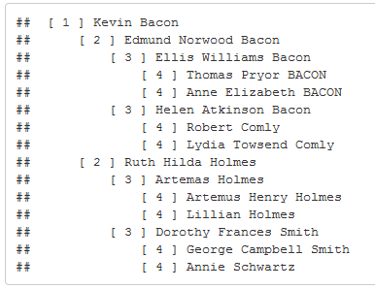
Run #1 Printouts: Kevin Bacon
1 = Kevin Bacon
2 = Parents
3 = Grandparents
4 = Great Grandparents

Slide 7
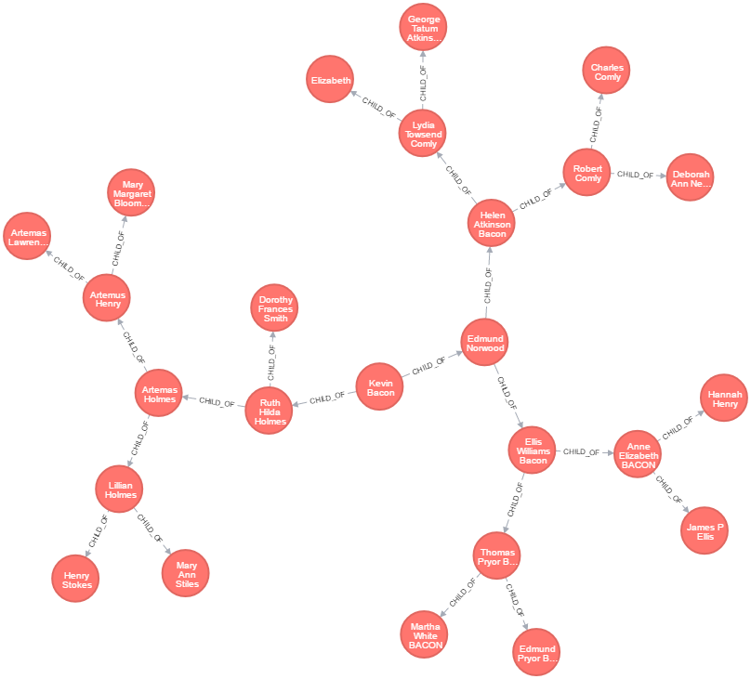
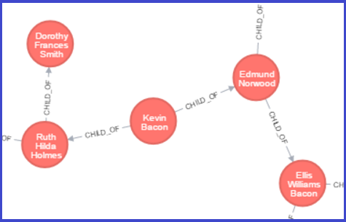
Run #1 Neo4j Graph: Kevin Bacon

Slide 8
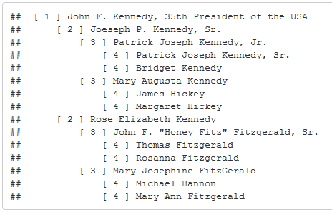
Run #2 Printouts: JFK
1 = John F. Kennedy
2 = Parents
3 = Grandparents
4 = Great Grandparents

Slide 9

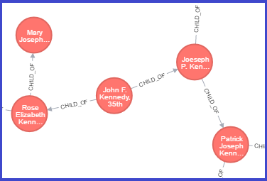
Run #2 Neo4j Graph: JFK

Slide 10
Intersection Data Simulation
Section 5.5 #3 - p222

Slide 11
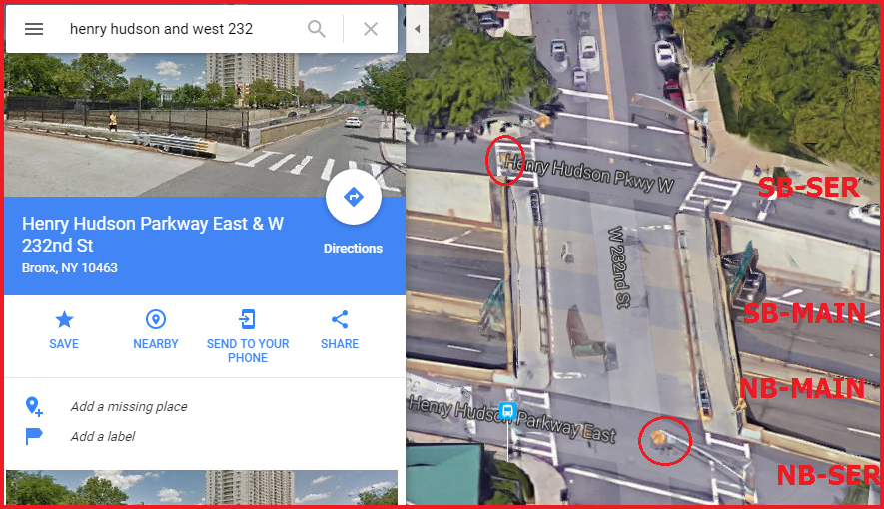
Henry Hudson Pkwy and E 232nd St. (Arial)

Slide 12
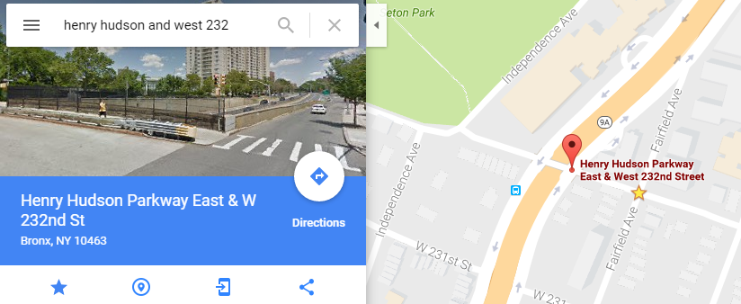
Henry Hudson Pkwy and E 232nd St. (Ground, Map)

Slide 13
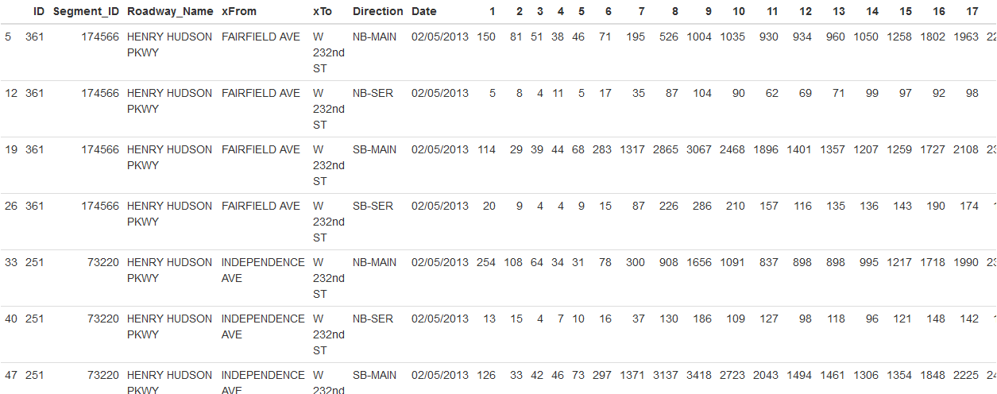
Traffic Data in original Wide Format

Slide 14
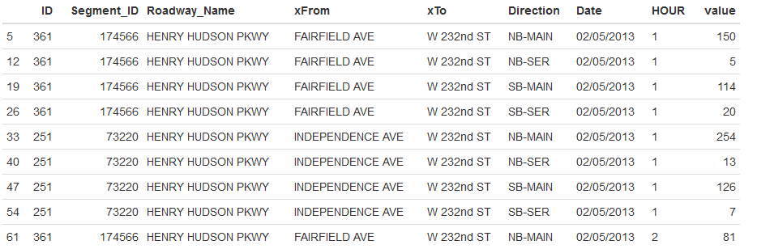
Traffic Data “Reshaped” to Long Format

Slide 15
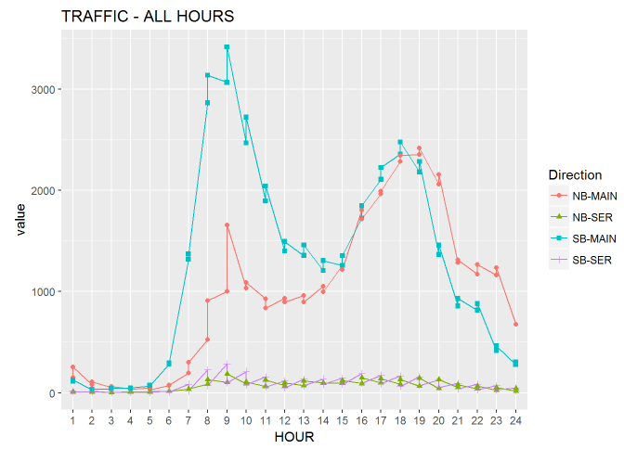
HOURLY data for sample date: (02/05/2013)

Slide 16
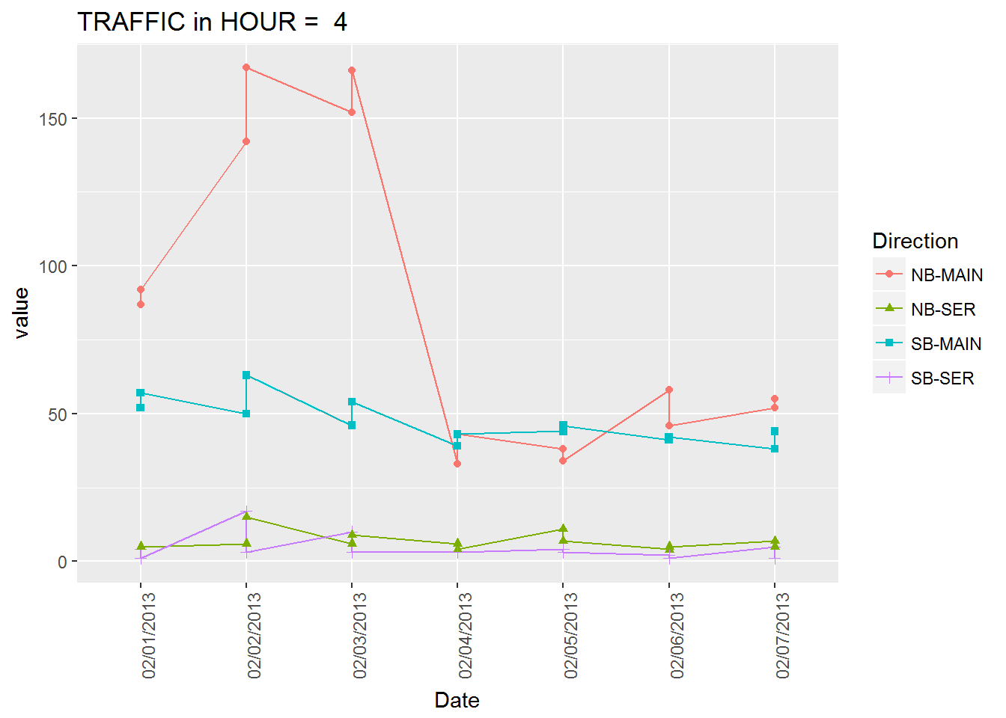
Maybe Hour 4 is Random?

Slide 17
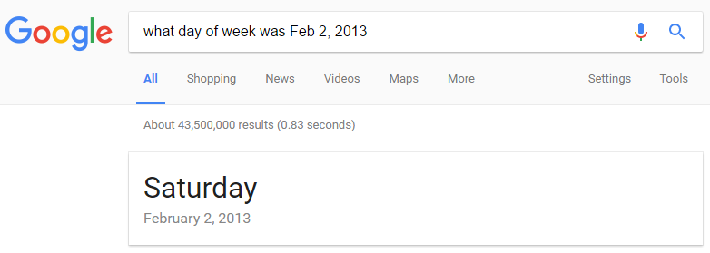
Aah, those are Weekend Days...

Slide 18
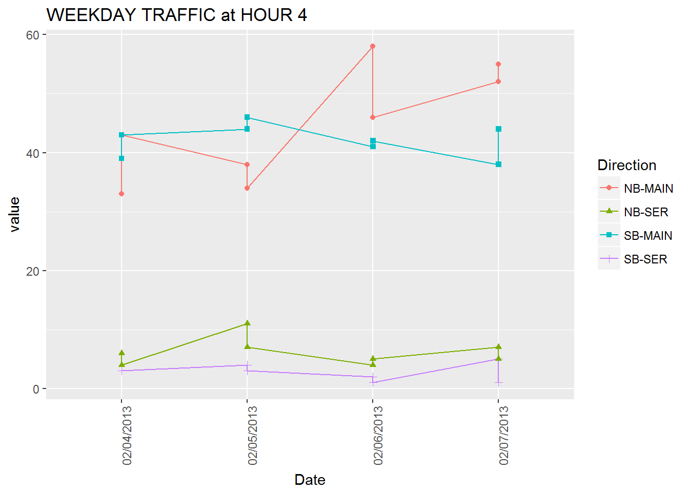
Use only the final 4 Weekdays for Rush Hour

Slide 19
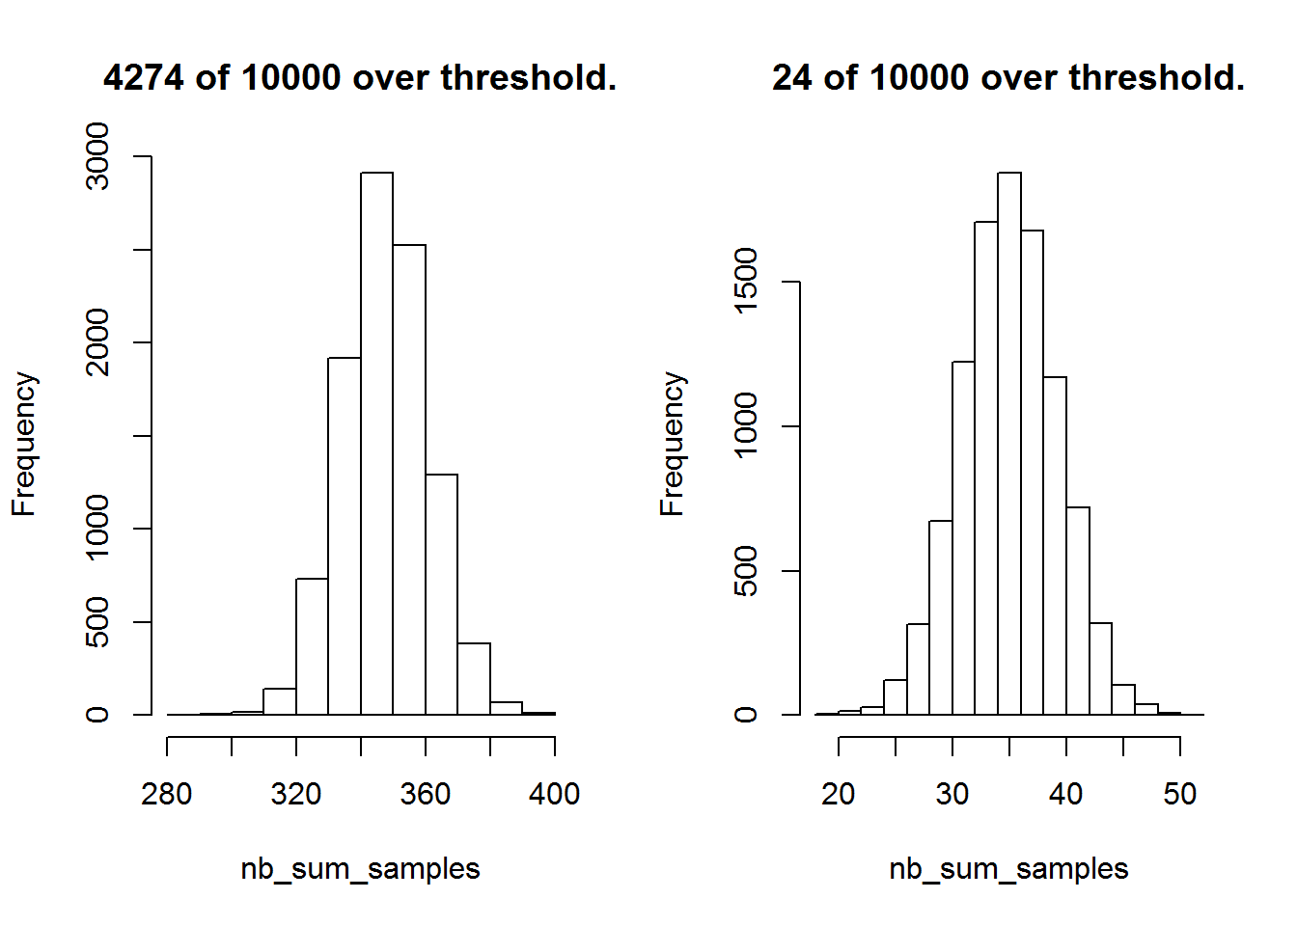
Monte Carlo Simulation:

Slide 20
Conclusions:
The probability that MAIN road fits null hypothesis (no direction bias) at hour 4 is: 0.4274
The probability that SERVICE road fits null hypothes (no direction bias) at hour 4 is: 0.0024

